Slide 2
1
The first shell always has to have 2 electrons!

Slide 3
Protons – are the positive particles with the heavy mass
Neutrons – neutral with heavy mass
Electrons-negative with a small mass

Slide 5
4
If it gained 3 electrons it would have a -3 charge.

Slide 6
FALSE
FALSE-atomic mass is protons plus neutrons

Slide 8
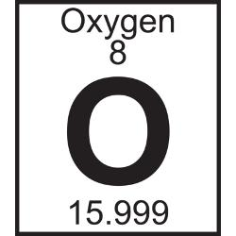

Slide 9
Atomic number is just the protons.
Atomic mass is protons + neutrons

Slide 10
Same elements – have the same protons
10

Slide 12
12
Electrons have a negative charge---if you have an extra electron the charge will be negative

Slide 13
The nucleus of sodium has a +11 charge
84-36=48 neutrons

Slide 14
10 electrons = NEON

Slide 15
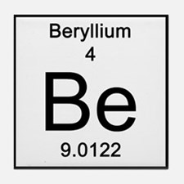
16
Protons=4
Electrons=4
Neutrons=5

Slide 16
lo
If it loses electrons…there will be more protons and therefore be POSITIVE

Slide 18
20
Atomic mass is equal to protons + neutrons

Slide 19
The nucleus is protons and neutrons. Protons are positive!

Slide 20
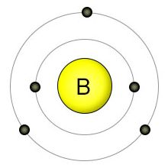
22
5P
6N

